Slide 1
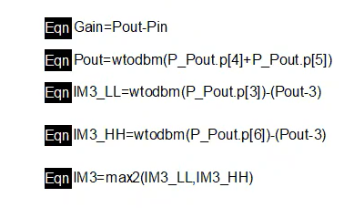
Equations for Lab-4

Slide 2
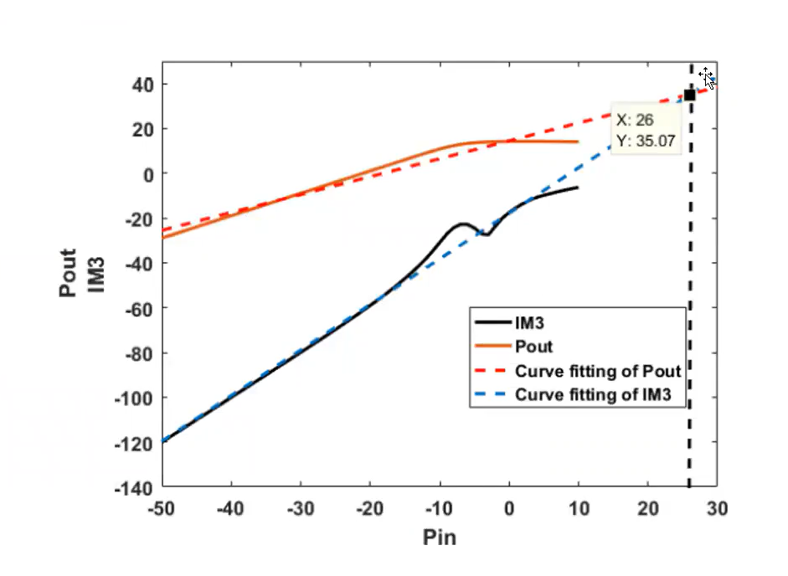
IP-3 Calculation Guidance

Slide 3
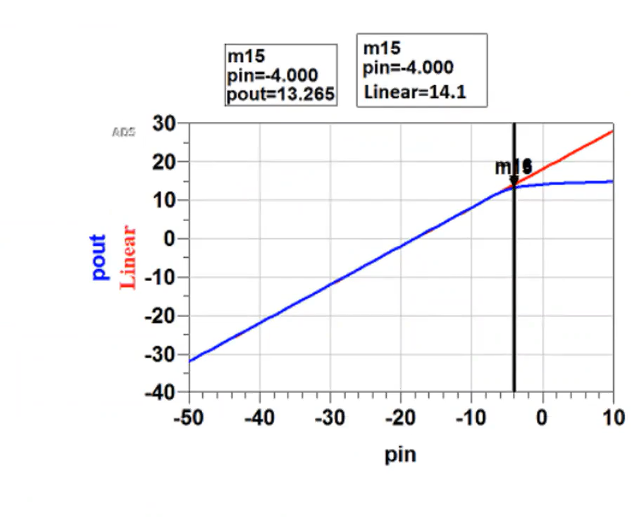
P1dB Compression Point

